Slide 1
The Battle of Neighborhoods
2021/04/14
By Ching-Hsuan CHEN

Slide 2
Business problem
How to keep fit/lose weight have been a hot topic all over the world.
I want to open a restaurant that focuses on low GI diet.
I choose Kaohsiung city as my target city.
Kaohsiung city is the second large city in Taiwan (the largest city is Taipei).

Slide 3
DATA
Basic districts data and basic census data is scraped from Wikipedia.
Detailed census data is downloaded from website of Kaohsiung government and Taiwan government.
Geospatial data is from geopy and Foursquare.
The data is not up to date, but it is the latest version I can get.

Slide 4
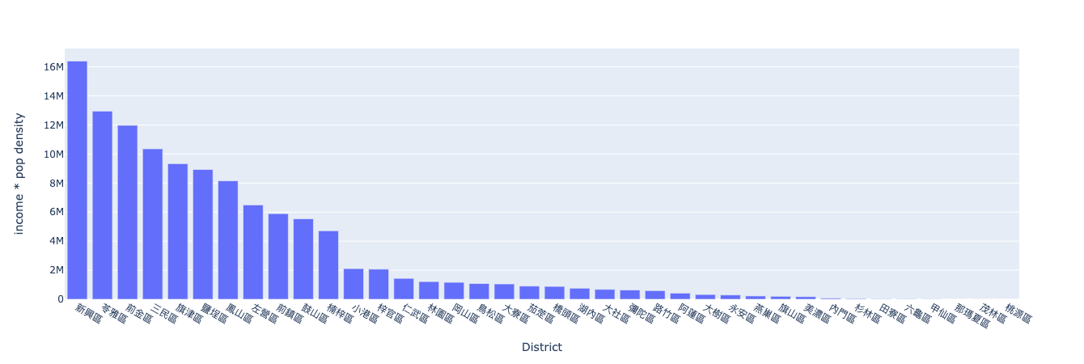
Population and income
Generally, healthy food is more expensive.
Eating healthy is an everyday thing. It's better to choose a place with high population density.
Income * population density of each district is as this chart:

Slide 5
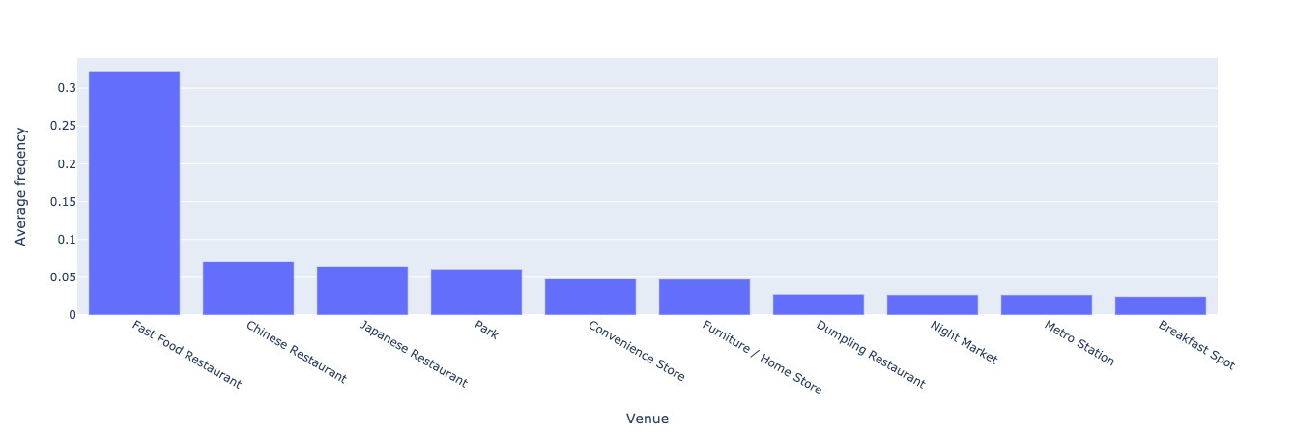
Neighborhood types
Healthy food restaurants need customers who care about their health. -> I would like to find a “healthy area” in Kaohsiung city.
I used KMeans clustering algorithm to group similar neighborhoods by their nearby venues,.
Some “not-healthy” groups were found since their top venues are fast food restaurants or smoke shops.

Slide 6
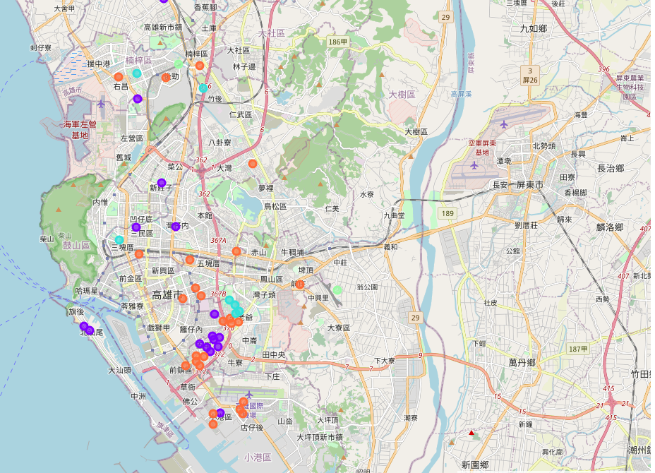
where i should not choose
My restaurant should not be too close to these neighborhoods
Because people there like fast food than other food.

Slide 7
where i should choose
Near gym/fitness centers: People there would be my main customers.
Near schools Students usually don’t like healthy food. But teathers and students’ parents may like.
Near metro stations, bus stops and train stations: Stream of people means stream of customers.
Near banks In Taiwan, female like helthy food more thsn male does. And there are more female workers than male workers in banks. Plus, all workers there are required to wear uniform. So I think they are also my potential customers.
Near hospital Workers there tend to pay more attention to health issues.

Slide 8
where i should choose (Cont')
I search for all kinds of venue categories I need.
I visualize the venue results on the map.
I also visualize income * population for every district as bubble chart.
The bigger the bubble is , the higherpopulation density the district is. And so is income.

Slide 9
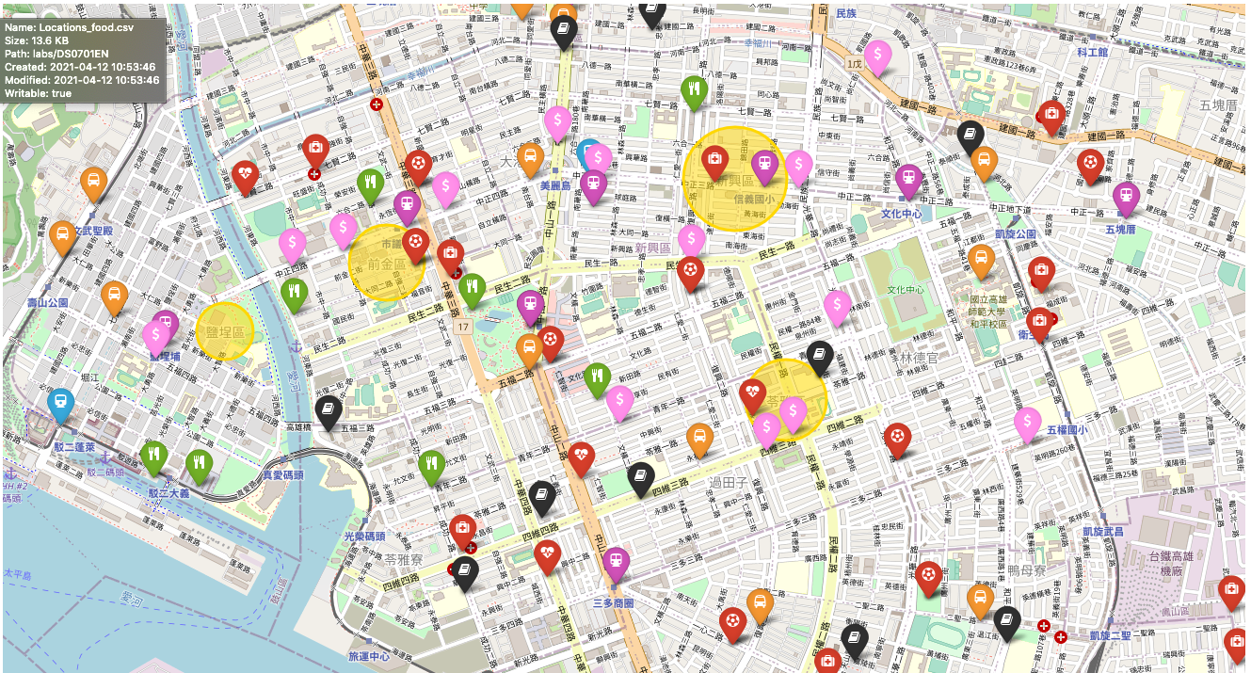
better districts for my restaurant

Slide 10
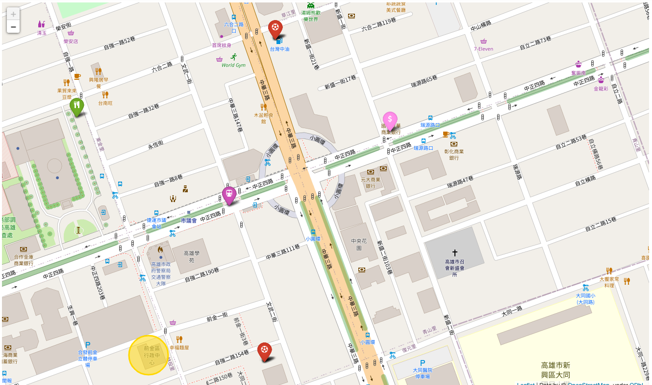
Final location
I choose the circle/roundabout in this screenshot.

Slide 11
Advantages of this place
Residents:
Income median * population density here is higher than other districts.
They are not in “not-healthy” group
Environment:
A metro station is very close. It will bring me a big stream of people.
In around 300m~500m, there are several banks (potential customers 1).
In around 500m~800m, there are two fitness centers (potential customers 2).
In around 1 km, there are two elementary schools (potential customers 3).
In around 1 km, there is one hospital (potential customers 4).

Slide 12
END
Thank you very much!

